Slide 1
Algorithm Analysis and Design Advanced Data Structure (B Tree) (Deletion)
Lecture -33-35

Slide 2
Overview
B-trees are balanced search trees designed to work well on magnetic disks or other direct-access secondary storage devices.
Time complexity of B Tree in big O notation
Algorithm Average Worst case
Space O(n) O(n)
Search O(log n) O(log n)
Insert O(log n) O(log n)
Delete O(log n) O(log n)

Slide 3
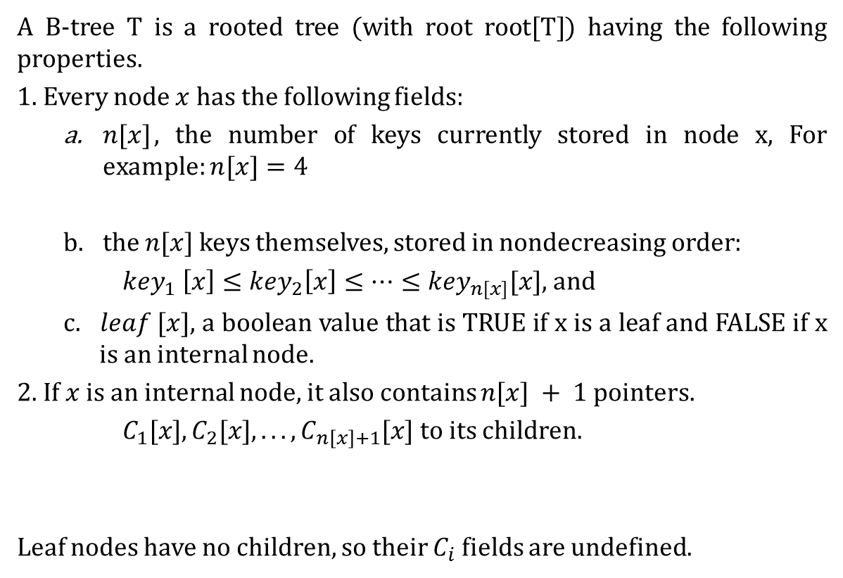
B Tree
A B-tree T is a rooted tree (with root root[T]) having the following properties.
1. Every node $x$has the following fields:
$n[x]$, the number of keys currently stored in node x, For example: $n[x]=4$
the $n[x]$ keys themselves, stored in nondecreasing order:
${key}_{1} \left[x\right]≤{key}_{2}\left[x\right]≤…≤{key}_{n[x]}[x],$ and
c. $leaf [x]$, a boolean value that is TRUE if x is a leaf and FALSE if x is an internal node.
2. If $x$ is an internal node, it also contains $n[x] + 1$pointers.
$C_{1}[x],C_{2}[x], . . . ,C_{n\left[x\right]+1}[x]$to its children.
Leaf nodes have no children, so their $C_{i}$ fields are undefined.
5
8
12
5
5
8
12
13

Slide 4
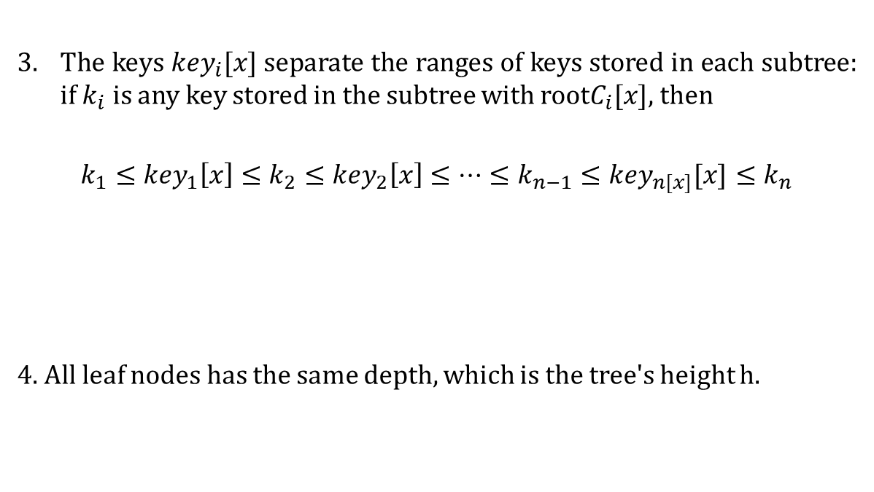
B Tree
3. The keys ${key}_{i}[x]$separate the ranges of keys stored in each subtree: if $k_{i}$ is any key stored in the subtree with root$C_{i}[x]$, then
$k_{1}≤{key}_{1}\left[x\right]≤k_{2}≤{key}_{2}\left[x\right]≤…≤k_{n−1}≤{key}_{n[x]}[x]$ $≤k_{n}$
4. All leaf nodes has the same depth, which is the tree's height h.
5
8
12
13

Slide 5
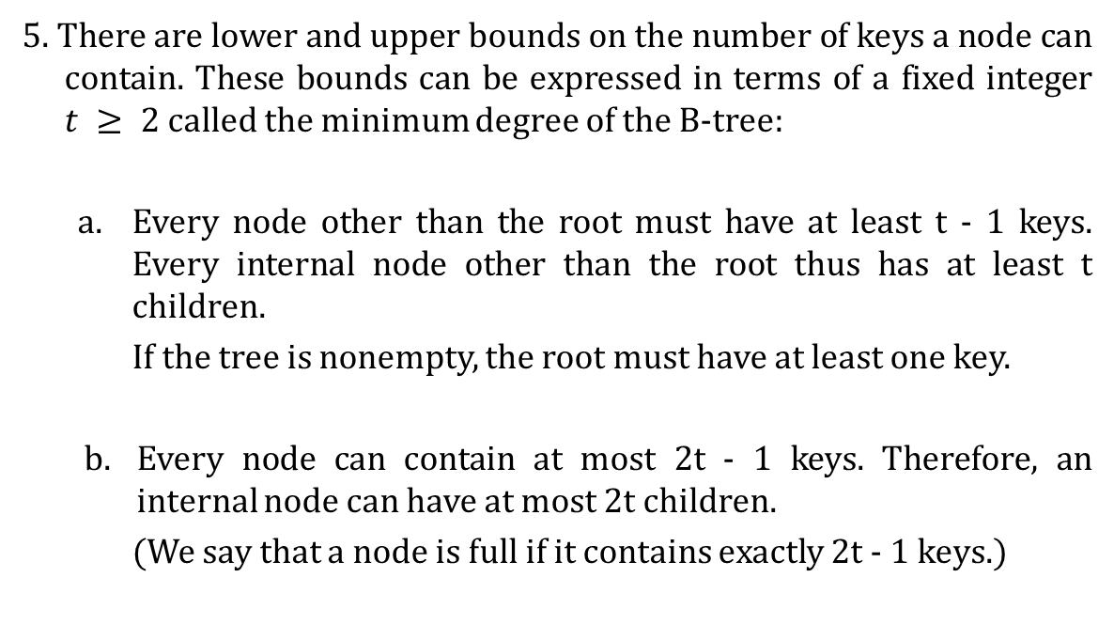
B Tree
5. There are lower and upper bounds on the number of keys a node can contain. These bounds can be expressed in terms of a fixed integer $t ≥ 2$ called the minimum degree of the B-tree:
Every node other than the root must have at least t - 1 keys. Every internal node other than the root thus has at least t children.
If the tree is nonempty, the root must have at least one key.
Every node can contain at most 2t - 1 keys. Therefore, an internal node can have at most 2t children.
(We say that a node is full if it contains exactly 2t - 1 keys.)

Slide 6
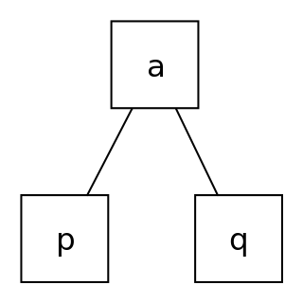
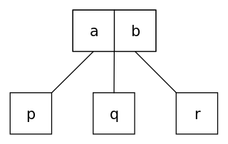
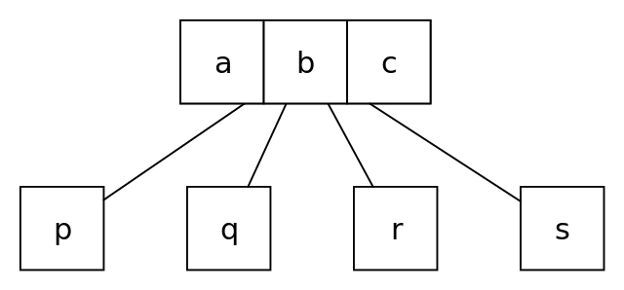
B Tree
The simplest B-tree occurs when t = 2. Every internal node then has either 2, 3, or 4 children, and we have a 2-3-4 tree.
a 2-node has one data element, and if internal has two child nodes;
a 3-node has two data elements, and if internal has three child nodes;
a 4-node has three data elements, and if internal has four child nodes;
For Example
In practice, however, much larger values of t are typically used.

Slide 7
B Tree (Insertion)
Example 1:
Draw a B-Tree of minimum degree t=3 of the given sequence and assume that B-Tree is initially empty.
<78, 56, 52, 95, 88, 105, 15, 35, 22, 47, 43, 50, 19, 31, 40, 41, 59>
So, The required minimum key =t-1=3-1=2
The required maximum key = 2t-1=6-1=5

Slide 8
B Tree (Insertion)
Example 1:
Draw a B-Tree of minimum degree t=3 of the given sequence and assume that B-Tree is initially empty.
<78, 56, 52, 95, 88, 105, 15, 35, 22, 47, 43, 50, 19, 31, 40, 41, 59>
So, The required minimum key =t-1=3-1=2
The required maximum key = 2t-1=6-1=5
Insert : 78
78

Slide 9
B Tree (Insertion)
Example 1:
Draw a B-Tree of minimum degree t=3 of the given sequence and assume that B-Tree is initially empty.
<78, 56, 52, 95, 88, 105, 15, 35, 22, 47, 43, 50, 19, 31, 40, 41, 59>
So, The required minimum key =t-1=3-1=2
The required maximum key = 2t-1=6-1=5
Insert : 78
Insert : 56
78
56
78

Slide 10
B Tree (Insertion)
Example 1:
Draw a B-Tree of minimum degree t=3 of the given sequence and assume that B-Tree is initially empty.
<78, 56, 52, 95, 88, 105, 15, 35, 22, 47, 43, 50, 19, 31, 40, 41, 59>
Insert : 52
52
56
78

Slide 11
B Tree (Insertion)
Example 1:
Draw a B-Tree of minimum degree t=3 of the given sequence and assume that B-Tree is initially empty.
<78, 56, 52, 95, 88, 105, 15, 35, 22, 47, 43, 50, 19, 31, 40, 41, 59>
Insert : 52
Insert : 95
52
56
78
52
56
78
95

Slide 12
B Tree (Insertion)
Example 1:
Draw a B-Tree of minimum degree t=3 of the given sequence and assume that B-Tree is initially empty.
<78, 56, 52, 95, 88, 105, 15, 35, 22, 47, 43, 50, 19, 31, 40, 41, 59>
Insert : 52
Insert : 95
Insert : 88
52
56
78
52
56
78
95
52
56
78
88
95

Slide 13
B Tree (Insertion)
Example 1:
Draw a B-Tree of minimum degree t=3 of the given sequence and assume that B-Tree is initially empty.
<78, 56, 52, 95, 88, 105, 15, 35, 22, 47, 43, 50, 19, 31, 40, 41, 59>
52
56
78
88
95

Slide 14
B Tree (Insertion)
Example 1:
Draw a B-Tree of minimum degree t=3 of the given sequence and assume that B-Tree is initially empty.
<78, 56, 52, 95, 88, 105, 15, 35, 22, 47, 43, 50, 19, 31, 40, 41, 59>
Now we can’t insert a new key into an existing leaf node as the maximum key size limit is achieved.
Hence we introduced a split function , which split the tree by it’s median key y.
52
56
78
88
95

Slide 15
B Tree (Insertion)
Example 1:
Draw a B-Tree of minimum degree t=3 of the given sequence and assume that B-Tree is initially empty.
<78, 56, 52, 95, 88, 105, 15, 35, 22, 47, 43, 50, 19, 31, 40, 41, 59>
First split and then Insert : 105
78
52
56
88
95

Slide 16
B Tree (Insertion)
Example 1:
Draw a B-Tree of minimum degree t=3 of the given sequence and assume that B-Tree is initially empty.
<78, 56, 52, 95, 88, 105, 15, 35, 22, 47, 43, 50, 19, 31, 40, 41, 59>
Insert : 105
78
52
56
88
95
105

Slide 17
B Tree (Insertion)
Example 1:
Draw a B-Tree of minimum degree t=3 of the given sequence and assume that B-Tree is initially empty.
<78, 56, 52, 95, 88, 105, 15, 35, 22, 47, 43, 50, 19, 31, 40, 41, 59>
Insert : 15
78
15
52
56
88
95
105

Slide 18
B Tree (Insertion)
Example 1:
Draw a B-Tree of minimum degree t=3 of the given sequence and assume that B-Tree is initially empty.
<78, 56, 52, 95, 88, 105, 15, 35, 22, 47, 43, 50, 19, 31, 40, 41, 59>
Insert : 35
78
15
35
52
56
88
95
105

Slide 19
B Tree (Insertion)
Example 1:
Draw a B-Tree of minimum degree t=3 of the given sequence and assume that B-Tree is initially empty.
<78, 56, 52, 95, 88, 105, 15, 35, 22, 47, 43, 50, 19, 31, 40, 41, 59>
Insert : 22
78
15
22
35
52
56
88
95
105

Slide 20
B Tree (Insertion)
Example 1:
Draw a B-Tree of minimum degree t=3 of the given sequence and assume that B-Tree is initially empty.
<78, 56, 52, 95, 88, 105, 15, 35, 22, 47, 43, 50, 19, 31, 40, 41, 59>
Insert : 22
78
15
22
35
52
56
88
95
105

Slide 21
B Tree (Insertion)
Example 1:
Draw a B-Tree of minimum degree t=3 of the given sequence and assume that B-Tree is initially empty.
<78, 56, 52, 95, 88, 105, 15, 35, 22, 47, 43, 50, 19, 31, 40, 41, 59>
Insert : 22
78
15
22
35
52
56
88
95
105
First Split then insert

Slide 22
B Tree (Insertion)
Example 1:
Draw a B-Tree of minimum degree t=3 of the given sequence and assume that B-Tree is initially empty.
<78, 56, 52, 95, 88, 105, 15, 35, 22, 47, 43, 50, 19, 31, 40, 41, 59>
First split and then Insert :47
35
78
15
22
52
56
88
95
105

Slide 23
B Tree (Insertion)
Example 1:
Draw a B-Tree of minimum degree t=3 of the given sequence and assume that B-Tree is initially empty.
<78, 56, 52, 95, 88, 105, 15, 35, 22, 47, 43, 50, 19, 31, 40, 41, 59>
First split and then Insert : 47
35
78
15
22
47
52
56
88
95
105

Slide 24
B Tree (Insertion)
Example 1:
Draw a B-Tree of minimum degree t=3 of the given sequence and assume that B-Tree is initially empty.
<78, 56, 52, 95, 88, 105, 15, 35, 22, 47, 43, 50, 19, 31, 40, 41, 59>
Insert : 43
35
78
15
22
43
47
52
56
88
95
105

Slide 25
B Tree (Insertion)
Example 1:
Draw a B-Tree of minimum degree t=3 of the given sequence and assume that B-Tree is initially empty.
<78, 56, 52, 95, 88, 105, 15, 35, 22, 47, 43, 50, 19, 31, 40, 41, 59>
Insert : 50
35
78
15
22
43
47
50
52
56
88
95
105

Slide 26
B Tree (Insertion)
Example 1:
Draw a B-Tree of minimum degree t=3 of the given sequence and assume that B-Tree is initially empty.
<78, 56, 52, 95, 88, 105, 15, 35, 22, 47, 43, 50, 19, 31, 40, 41, 59>
Insert : 19
35
78
15
19
22
43
47
50
52
56
88
95
105

Slide 27
B Tree (Insertion)
Example 1:
Draw a B-Tree of minimum degree t=3 of the given sequence and assume that B-Tree is initially empty.
<78, 56, 52, 95, 88, 105, 15, 35, 22, 47, 43, 50, 19, 31, 40, 41, 59>
Insert : 31
35
78
15
19
22
31
43
47
50
52
56
88
95
105

Slide 28
B Tree (Insertion)
Example 1:
Draw a B-Tree of minimum degree t=3 of the given sequence and assume that B-Tree is initially empty.
<78, 56, 52, 95, 88, 105, 15, 35, 22, 47, 43, 50, 19, 31, 40, 41, 59>
Insert : 40
35
78
15
19
22
31
43
47
50
52
56
88
95
105

Slide 29
B Tree (Insertion)
Example 1:
Draw a B-Tree of minimum degree t=3 of the given sequence and assume that B-Tree is initially empty.
<78, 56, 52, 95, 88, 105, 15, 35, 22, 47, 43, 50, 19, 31, 40, 41, 59>
First split and then Insert : 40
35
78
15
19
22
31
43
47
50
52
56
88
95
105

Slide 30
B Tree (Insertion)
Example 1:
Draw a B-Tree of minimum degree t=3 of the given sequence and assume that B-Tree is initially empty.
<78, 56, 52, 95, 88, 105, 15, 35, 22, 47, 43, 50, 19, 31, 40, 41, 59>
First split and then Insert : 40
35
50
78
15
19
22
31
43
47
52
56
88
95
105

Slide 31
B Tree (Insertion)
Example 1:
Draw a B-Tree of minimum degree t=3 of the given sequence and assume that B-Tree is initially empty.
<78, 56, 52, 95, 88, 105, 15, 35, 22, 47, 43, 50, 19, 31, 40, 41, 59>
First split and then Insert : 40
35
50
78
15
19
22
31
40
43
47
52
56
88
95
105

Slide 32
B Tree (Insertion)
Example 1:
Draw a B-Tree of minimum degree t=3 of the given sequence and assume that B-Tree is initially empty.
<78, 56, 52, 95, 88, 105, 15, 35, 22, 47, 43, 50, 19, 31, 40, 41, 59>
Insert : 41
35
50
78
15
19
22
31
40
41
43
47
52
56
88
95
105

Slide 33
B Tree (Insertion)
Example 1:
Draw a B-Tree of minimum degree t=3 of the given sequence and assume that B-Tree is initially empty.
<78, 56, 52, 95, 88, 105, 15, 35, 22, 47, 43, 50, 19, 31, 40, 41, 59>
Insert : 59
35
50
78
15
19
22
31
40
41
43
47
52
56
59
88
95
105

Slide 34
B Tree (Insertion)
Example 2:
Construct a B-Tree of degree t=3 on following data set and assume that B-Tree is initially empty.
<E, A, S, Y, Q, U, E, S, T, I, O, N, I, N, C>

Slide 35
B Tree (Insertion)
Example 2:
Construct a B-Tree of degree t=3 on following data set and assume that B-Tree is initially empty.
<E, A, S, Y, Q, U, E, S, T, I, O, N, I, N, C>
Insert : E
E

Slide 36
B Tree (Insertion)
Example 2:
Construct a B-Tree of degree t=3 on following data set and assume that B-Tree is initially empty.
<E, A, S, Y, Q, U, E, S, T, I, O, N, I, N, C>
Insert : E
Insert : A
E
A
E

Slide 37
B Tree (Insertion)
Example 2:
Construct a B-Tree of degree t=3 on following data set and assume that B-Tree is initially empty.
<E, A, S, Y, Q, U, E, S, T, I, O, N, I, N, C>
Insert : E
Insert : A
Insert : S
E
A
E
A
E
S

Slide 38
B Tree (Insertion)
Example 2:
Construct a B-Tree of degree t=3 on following data set and assume that B-Tree is initially empty.
<E, A, S, Y, Q, U, E, S, T, I, O, N, I, N, C>
Insert : E
Insert : A
Insert : S
Insert : Y
E
A
E
A
E
S
A
E
S
Y

Slide 39
B Tree (Insertion)
Example 2:
Construct a B-Tree of degree t=3 on following data set and assume that B-Tree is initially empty.
<E, A, S, Y, Q, U, E, S, T, I, O, N, I, N, C>
Insert : Q
A
E
Q
S
Y

Slide 40
B Tree (Insertion)
Example 2:
Construct a B-Tree of degree t=3 on following data set and assume that B-Tree is initially empty.
<E, A, S, Y, Q, U, E, S, T, I, O, N, I, N, C>
Insert : Q
A
E
Q
S
Y
First Split then insert

Slide 41
B Tree (Insertion)
Example 2:
Construct a B-Tree of degree t=3 on following data set and assume that B-Tree is initially empty.
<E, A, S, Y, Q, U, E, S, T, I, O, N, I, N, C>
First split and then Insert : U
Q
A
E
S
Y

Slide 42
B Tree (Insertion)
Example 2:
Construct a B-Tree of degree t=3 on following data set and assume that B-Tree is initially empty.
<E, A, S, Y, Q, U, E, S, T, I, O, N, I, N, C>
First split and then Insert : U
Q
A
E
S
U
Y

Slide 43
B Tree (Insertion)
Example 2:
Construct a B-Tree of degree t=3 on following data set and assume that B-Tree is initially empty.
<E, A, S, Y, Q, U, E, S, T, I, O, N, I, N, C>
Insert : E
Q
A
E
E
S
U
Y

Slide 44
B Tree (Insertion)
Example 2:
Construct a B-Tree of degree t=3 on following data set and assume that B-Tree is initially empty.
<E, A, S, Y, Q, U, E, S, T, I, O, N, I, N, C>
Insert : S
Q
A
E
E
S
S
U
Y

Slide 45
B Tree (Insertion)
Example 2:
Construct a B-Tree of degree t=3 on following data set and assume that B-Tree is initially empty.
<E, A, S, Y, Q, U, E, S, T, I, O, N, I, N, C>
Insert : T
Q
A
E
E
S
S
T
U
Y

Slide 46
B Tree (Insertion)
Example 2:
Construct a B-Tree of degree t=3 on following data set and assume that B-Tree is initially empty.
<E, A, S, Y, Q, U, E, S, T, I, O, N, I, N, C>
Insert : I
Q
A
E
E
I
S
S
T
U
Y

Slide 47
B Tree (Insertion)
Example 2:
Construct a B-Tree of degree t=3 on following data set and assume that B-Tree is initially empty.
<E, A, S, Y, Q, U, E, S, T, I, O, N, I, N, C>
Insert : O
Q
A
E
E
I
O
S
S
T
U
Y

Slide 48
B Tree (Insertion)
Example 2:
Construct a B-Tree of degree t=3 on following data set and assume that B-Tree is initially empty.
<E, A, S, Y, Q, U, E, S, T, I, O, N, I, N, C>
Insert : N
Q
A
E
E
I
O
S
S
T
U
Y

Slide 49
B Tree (Insertion)
Example 2:
Construct a B-Tree of degree t=3 on following data set and assume that B-Tree is initially empty.
<E, A, S, Y, Q, U, E, S, T, I, O, N, I, N, C>
Insert : N
Q
A
E
E
I
O
S
S
T
U
Y
First Split then insert

Slide 50
B Tree (Insertion)
Example 2:
Construct a B-Tree of degree t=3 on following data set and assume that B-Tree is initially empty.
<E, A, S, Y, Q, U, E, S, T, I, O, N, I, N, C>
Insert : N
E
Q
A
E
I
N
O
S
S
T
U
Y

Slide 51
B Tree (Insertion)
Example 2:
Construct a B-Tree of degree t=3 on following data set and assume that B-Tree is initially empty.
<E, A, S, Y, Q, U, E, S, T, I, O, N, I, N, C>
Insert : I
E
Q
A
E
I
I
N
O
S
S
T
U
Y

Slide 52
B Tree (Insertion)
Example 2:
Construct a B-Tree of degree t=3 on following data set and assume that B-Tree is initially empty.
<E, A, S, Y, Q, U, E, S, T, I, O, N, I, N, C>
Insert : N
E
Q
A
E
I
I
N
N
O
S
S
T
U
Y

Slide 53
B Tree (Insertion)
Example 2:
Construct a B-Tree of degree t=3 on following data set and assume that B-Tree is initially empty.
<E, A, S, Y, Q, U, E, S, T, I, O, N, I, N, C>
Insert : C
E
Q
A
C
E
I
I
N
N
O
S
S
T
U
Y

Slide 54
B Tree (Insertion)
Example 2:
Construct a B-Tree of degree t=3 on following data set and assume that B-Tree is initially empty.
<E, A, S, Y, Q, U, E, S, T, I, O, N, I, N, C>
Insert : C
E
Q
A
C
E
I
I
N
N
O
S
S
T
U
Y

Slide 55
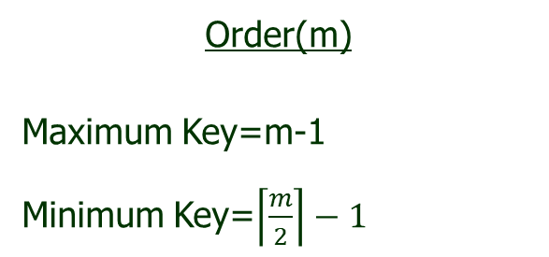
B Tree (Insertion)
A B-Tree can be constructed by order as well as degree.
The question is , how to find Maximum and Minimum key in both the case
Order(m)
Maximum Key=m-1
Minimum Key=$\left\lceil \frac{m}{2}\right\rceil −1$
Degree(t)
Maximum Key=2t-1
Minimum Key= t-1

Slide 56
B Tree (Insertion)
Example 3:
Construct a B-Tree of order 5 on following data set and assume that B-Tree is initially empty.
<F, S, Q, K, C, L, H, T, V, W, M, R, N, P, A, B, X, Y, Z, D, E>

Slide 57
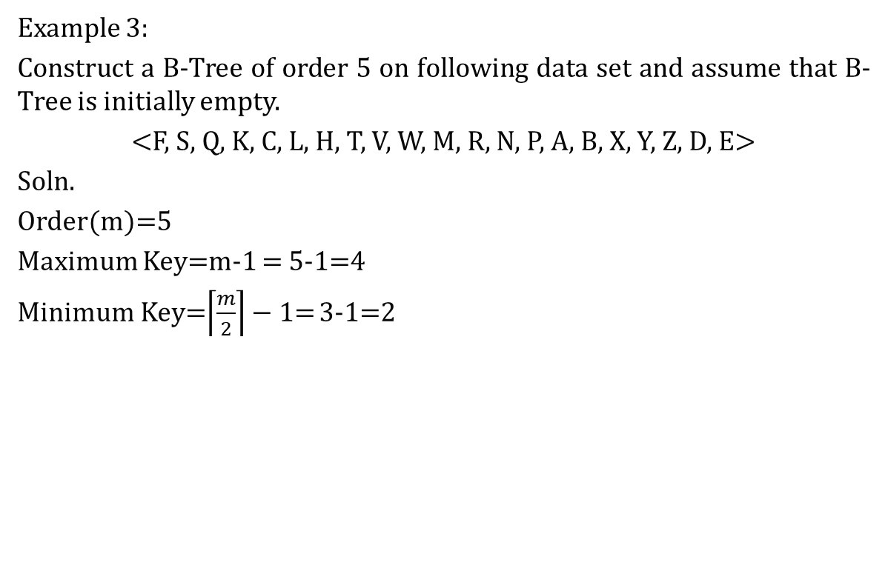
B Tree (Insertion)
Example 3:
Construct a B-Tree of order 5 on following data set and assume that B-Tree is initially empty.
<F, S, Q, K, C, L, H, T, V, W, M, R, N, P, A, B, X, Y, Z, D, E>
Soln.
Order(m)=5
Maximum Key=m-1 = 5-1=4
Minimum Key=$\left\lceil \frac{m}{2}\right\rceil −1$= 3-1=2

Slide 58
B Tree (Insertion)
Example 3:
Construct a B-Tree of order 5 on following data set and assume that B-Tree is initially empty.
<F, S, Q, K, C, L, H, T, V, W, M, R, N, P, A, B, X, Y, Z, D, E>
Insert: F
F

Slide 59
B Tree (Insertion)
Example 3:
Construct a B-Tree of order 5 on following data set and assume that B-Tree is initially empty.
<F, S, Q, K, C, L, H, T, V, W, M, R, N, P, A, B, X, Y, Z, D, E>
Insert: F
Insert: S
F
F
S

Slide 60
B Tree (Insertion)
Example 3:
Construct a B-Tree of order 5 on following data set and assume that B-Tree is initially empty.
<F, S, Q, K, C, L, H, T, V, W, M, R, N, P, A, B, X, Y, Z, D, E>
Insert: F
Insert: S
Insert: Q
F
F
S
F
Q
S

Slide 61
B Tree (Insertion)
Example 3:
Construct a B-Tree of order 5 on following data set and assume that B-Tree is initially empty.
<F, S, Q, K, C, L, H, T, V, W, M, R, N, P, A, B, X, Y, Z, D, E>
Insert: F
Insert: S
Insert: Q
Insert: K
F
F
S
F
Q
S
F
K
Q
S

Slide 62
B Tree (Insertion)
Example 3:
Construct a B-Tree of order 5 on following data set and assume that B-Tree is initially empty.
<F, S, Q, K, C, L, H, T, V, W, M, R, N, P, A, B, X, Y, Z, D, E>
Insert: F
Insert: S
Insert: Q
Insert: K
F
F
S
F
Q
S
F
K
Q
S

Slide 63
B Tree (Insertion)
Example 3:
Construct a B-Tree of order 5 on following data set and assume that B-Tree is initially empty.
<F, S, Q, K, C, L, H, T, V, W, M, R, N, P, A, B, X, Y, Z, D, E>
Insert: F
Insert: S
Insert: Q
Insert: K
F
F
S
F
Q
S
F
K
Q
S
First Split then insert

Slide 64
B Tree (Insertion)
Example 3:
Construct a B-Tree of order 5 on following data set and assume that B-Tree is initially empty.
<F, S, Q, K, C, L, H, T, V, W, M, R, N, P, A, B, X, Y, Z, D, E>
Insert: K
Rules for Splitting:
When the key elements are even and there is a need of split, at that time we get two median(i.e. m and m+1), So on these cases following rules are helping for splitting.
Rule 1: If the inserted item is < m then split from ‘m’.
Rule 2: If the inserted item is >m+1 then split from ‘m+1’.
Rule 3: If the inserted item is > m and <m+1 then split on inserted item.
F
K
Q
S
First Split then insert

Slide 65
B Tree (Insertion)
Example 3:
Construct a B-Tree of order 5 on following data set and assume that B-Tree is initially empty.
<F, S, Q, K, C, L, H, T, V, W, M, R, N, P, A, B, X, Y, Z, D, E>
Insert: K
K
F
Q
S

Slide 66
B Tree (Insertion)
Example 3:
Construct a B-Tree of order 5 on following data set and assume that B-Tree is initially empty.
<F, S, Q, K, C, L, H, T, V, W, M, R, N, P, A, B, X, Y, Z, D, E>
Insert: K
Insert: C
K
F
Q
S
K
C
F
Q
S

Slide 67
B Tree (Insertion)
Example 3:
Construct a B-Tree of order 5 on following data set and assume that B-Tree is initially empty.
<F, S, Q, K, C, L, H, T, V, W, M, R, N, P, A, B, X, Y, Z, D, E>
Insert: L
K
C
F
L
Q
S

Slide 68
B Tree (Insertion)
Example 3:
Construct a B-Tree of order 5 on following data set and assume that B-Tree is initially empty.
<F, S, Q, K, C, L, H, T, V, W, M, R, N, P, A, B, X, Y, Z, D, E>
Insert: L
Insert: H
K
C
F
L
Q
S
K
C
F
H
L
Q
S

Slide 69
B Tree (Insertion)
Example 3:
Construct a B-Tree of order 5 on following data set and assume that B-Tree is initially empty.
<F, S, Q, K, C, L, H, T, V, W, M, R, N, P, A, B, X, Y, Z, D, E>
Insert: T
K
C
F
H
L
Q
S
T

Slide 70
B Tree (Insertion)
Example 3:
Construct a B-Tree of order 5 on following data set and assume that B-Tree is initially empty.
<F, S, Q, K, C, L, H, T, V, W, M, R, N, P, A, B, X, Y, Z, D, E>
Insert: T
First Split then insert
K
C
F
H
L
Q
S
T

Slide 71
B Tree (Insertion)
Example 3:
Construct a B-Tree of order 5 on following data set and assume that B-Tree is initially empty.
<F, S, Q, K, C, L, H, T, V, W, M, R, N, P, A, B, X, Y, Z, D, E>
Insert: T
First Split then insert
K
C
F
H
L
Q
S
T
K
S
C
F
H
L
Q
T

Slide 72
B Tree (Insertion)
Example 3:
Construct a B-Tree of order 5 on following data set and assume that B-Tree is initially empty.
<F, S, Q, K, C, L, H, T, V, W, M, R, N, P, A, B, X, Y, Z, D, E>
Insert: V
K
S
C
F
H
L
Q
T
V

Slide 73
B Tree (Insertion)
Example 3:
Construct a B-Tree of order 5 on following data set and assume that B-Tree is initially empty.
<F, S, Q, K, C, L, H, T, V, W, M, R, N, P, A, B, X, Y, Z, D, E>
Insert: V
Insert: W
K
S
C
F
H
L
Q
T
V
K
S
C
F
H
L
Q
T
V
W

Slide 74
B Tree (Insertion)
Example 3:
Construct a B-Tree of order 5 on following data set and assume that B-Tree is initially empty.
<F, S, Q, K, C, L, H, T, V, W, M, R, N, P, A, B, X, Y, Z, D, E>
Insert: M
K
S
C
F
H
L
M
Q
T
V
W

Slide 75
B Tree (Insertion)
Example 3:
Construct a B-Tree of order 5 on following data set and assume that B-Tree is initially empty.
<F, S, Q, K, C, L, H, T, V, W, M, R, N, P, A, B, X, Y, Z, D, E>
Insert: M
Insert: R
K
S
C
F
H
L
M
Q
T
V
W
K
S
C
F
H
L
M
Q
R
T
V
W

Slide 76
B Tree (Insertion)
Example 3:
Construct a B-Tree of order 5 on following data set and assume that B-Tree is initially empty.
<F, S, Q, K, C, L, H, T, V, W, M, R, N, P, A, B, X, Y, Z, D, E>
Insert: N
Insert and then Split
K
S
C
F
H
L
M
Q
R
T
V
W
K
N
S
C
F
H
L
M
Q
R
T
V
W

Slide 77
B Tree (Insertion)
Example 3:
Construct a B-Tree of order 5 on following data set and assume that B-Tree is initially empty.
<F, S, Q, K, C, L, H, T, V, W, M, R, N, P, A, B, X, Y, Z, D, E>
Insert: N
Insert: P
K
N
S
C
F
H
L
M
Q
R
T
V
W
K
N
S
C
F
H
L
M
P
Q
R
T
V
W

Slide 78
B Tree (Insertion)
Example 3:
Construct a B-Tree of order 5 on following data set and assume that B-Tree is initially empty.
<F, S, Q, K, C, L, H, T, V, W, M, R, N, P, A, B, X, Y, Z, D, E>
Insert: A
Insert: B (First Insert B then Split)
K
N
S
A
C
F
H
L
M
P
Q
R
T
V
W
C
N
S
A
B
H
L
M
P
Q
R
T
V
W

Slide 79
B Tree (Insertion)
Example 3:
Construct a B-Tree of order 5 on following data set and assume that B-Tree is initially empty.
<F, S, Q, K, C, L, H, T, V, W, M, R, N, P, A, B, X, Y, Z, D, E>
Insert: X
C
N
S
A
B
H
L
P
Q
R
T
V
W
X

Slide 80
B Tree (Insertion)
Example 3:
Construct a B-Tree of order 5 on following data set and assume that B-Tree is initially empty.
<F, S, Q, K, C, L, H, T, V, W, M, R, N, P, A, B, X, Y, Z, D, E>
Insert: X
Insert: Y (Insert Y and then split)
C
N
S
A
B
H
L
P
Q
R
T
V
W
X
C
N
S
A
B
H
L
P
Q
R
T
V
W
X

Slide 81
B Tree (Insertion)
Example 3:
Construct a B-Tree of order 5 on following data set and assume that B-Tree is initially empty.
<F, S, Q, K, C, L, H, T, V, W, M, R, N, P, A, B, X, Y, Z, D, E>
Insert: Y (Insert Y and then split and again insert W on Root and then again split)
C
S
W
A
B
H
L
P
Q
R
T
V
X
Y

Slide 82
B Tree (Insertion)
Example 3:
Construct a B-Tree of order 5 on following data set and assume that B-Tree is initially empty.
<F, S, Q, K, C, L, H, T, V, W, M, R, N, P, A, B, X, Y, Z, D, E>
Insert: Z
C
S
W
A
B
H
L
P
Q
R
T
V
X
Y
Z

Slide 83
B Tree (Insertion)
Example 3:
Construct a B-Tree of order 5 on following data set and assume that B-Tree is initially empty.
<F, S, Q, K, C, L, H, T, V, W, M, R, N, P, A, B, X, Y, Z, D, E>
Insert: D
C
S
W
A
D
H
L
P
Q
R
T
V
X
Y
Z

Slide 84
B Tree (Insertion)
Example 3:
Construct a B-Tree of order 5 on following data set and assume that B-Tree is initially empty.
<F, S, Q, K, C, L, H, T, V, W, M, R, N, P, A, B, X, Y, Z, D, E>
Insert: E
C
S
W
A
D
E
H
P
Q
R
T
V
X
Y
Z

Slide 85
B Tree (Deletion)

Slide 86
B Tree (Deletion)
Deletion from a B-tree is analogous to insertion but a little more complicated.
Let us sketch illustrates the various cases of deleting keys from a B-tree.
Case 1: If x (one of the key to be deleted from) is a leaf node and the leaf node have more than (t-1) keys then the key can just be removed without disturbing the tree.
Let the degree (t)=3
For Example:
D
G
Delete
D
G
B
A
B
C
E
F
H
Z
A
C
E
F
H
Z

Slide 87
B Tree (Deletion)
Case 2(a): if x (one of the key to be deleted from) is an internal node and the key left children have at least t key, then the largest value can be moved up to replace the k.
Let the degree (t)=3
For Example:
Q
U
Delete
Q
T
U
O
P
R
S
T
W
X
O
P
R
S
W
X

Slide 88
B Tree (Deletion)
Case 2(b): if x (one of the key to be deleted from) is an internal node and the key right children have at least t key, then the smallest value can be moved up to replace the k.
Let the degree (t)=3
For Example:
Q
U
Delete
R
U
Q
O
P
R
S
T
W
X
O
P
S
T
W
X

Slide 89
B Tree (Deletion)
Case 2(c): if x (one of the key to be deleted from) is an internal node neither its child has at least t keys then the two childs of keys must be merge into one and key must be removed.
Let the degree (t)=3
For Example:
Delete
R
X
R
U
X
U
P
Q
S
T
V
W
Y
Z
P
Q
S
T
V
W
Y
Z

Slide 90

B Tree (Deletion)
Case 3:
If the key k is not present in internal node x, determine the root of the appropriate subtree that must contain k, if k is in the tree at all.
If x has only $t−1$ keys, execute step 3a or 3b as necessary to guarantee that we descend to a node containing at least t keys. Then finish by recursing on the appropriate child of x.

Slide 91
B Tree (Deletion)
Case 3 (a): If x has (t-1) keys but has an immediate sibling with at least t keys, give x an extra key by moving a key from p[x] down into x, moving a key from x’s immediate left or right sibling up into p[x], and moving the appropriate child pointer from the sibling into x.
Let the degree (t)=3
For Example:
C
L
P
T
X
A
B
E
J
K
N
O
Q
R
S
U
V
Y
Z
Delete
B
E
L
P
T
X
A
C
J
K
N
O
Q
R
S
U
V
Y
Z

Slide 92
B Tree (Deletion)
Case 3: If x has (t-1) keys
(b) if p[x] (one of the key to be deleted from) and its immediate sibling also have (t-1) keys, then merge p[x] with one of its sibling by bringing down the p[p[x]] to be the median value and then delete the desired key.
Let the degree (t)=3
For Example:
Delete
D
P
C
L
T
X
A
B
D
E
N
O
Q
R
S
U
V
Y
Z

Slide 93
B Tree (Deletion)
Case 3: If x has (t-1) keys
(b) if p[x] (one of the key to be deleted from) and its immediate sibling also have (t-1) keys, then merge p[x] with one of its sibling by bringing down the p[p[x]] to be the median value and then delete the desired key.
Let the degree (t)=3
For Example:
L
P
T
X
Delete
D
A
B
C
E
N
O
Q
R
S
U
V
Y
Z

Slide 94
B Tree (Deletion)
Example 1:
Perform the deletion operation with the following data sequentially on the given B-Tree of degree 3.
<T S U T D C I N R C>
D
R
T
A
A
C
C
E
G
I
N
R
S
S
T
T
U
U
U

Slide 95
B Tree (Deletion)
Example 1:
Perform the deletion operation with the following data sequentially on the given B-Tree of degree 3.
<T S U T D C I N R C>
Delete: T
D
R
T
key
A
A
C
C
E
G
I
N
R
S
S
T
T
U
U
U
Apply Case 2(b)

Slide 96
B Tree (Deletion)
Example 1:
Perform the deletion operation with the following data sequentially on the given B-Tree of degree 3.
<T S U T D C I N R C>
Delete: T
D
R
T
key
A
A
C
C
E
G
I
N
R
S
S
T
T
U
U
U
Apply Case 2(b)
D
R
T
key
A
A
C
C
E
G
I
N
R
S
S
T
T
U
U
U

Slide 97
B Tree (Deletion)
Example 1:
Perform the deletion operation with the following data sequentially on the given B-Tree of degree 3.
<T S U T D C I N R C>
The updated Tree is
D
R
T
A
A
C
C
E
G
I
N
R
S
S
T
U
U
U

Slide 98
B Tree (Deletion)
Example 1:
Perform the deletion operation with the following data sequentially on the given B-Tree of degree 3.
<T S U T D C I N R C>
Delete : S
D
R
T
A
A
C
C
E
G
I
N
R
S
S
key
T
U
U
U
Apply Case 3(a)
D
R
T
A
A
C
C
E
G
I
N
R
S
S
key
T
U
U
U

Slide 99
B Tree (Deletion)
Example 1:
Perform the deletion operation with the following data sequentially on the given B-Tree of degree 3.
<T S U T D C I N R C>
Delete : S
After Apply Case 3(a)
D
R
T
A
A
C
C
E
G
I
N
R
S
T
U
U
U

Slide 100
B Tree (Deletion)
Example 1:
Perform the deletion operation with the following data sequentially on the given B-Tree of degree 3.
<T S U T D C I N R C>
Delete : U
D
R
T
key
A
A
C
C
E
G
I
N
R
S
T
U
U
U

Slide 101
B Tree (Deletion)
Example 1:
Perform the deletion operation with the following data sequentially on the given B-Tree of degree 3.
<T S U T D C I N R C>
Delete : U
D
R
T
key
A
A
C
C
E
G
I
N
R
S
T
U
U
U
Apply Case 1

Slide 102
B Tree (Deletion)
Example 1:
Perform the deletion operation with the following data sequentially on the given B-Tree of degree 3.
<T S U T D C I N R C>
Delete : U
D
R
T
key
A
A
C
C
E
G
I
N
R
S
T
U
U
U
Apply Case 1
D
R
T
A
A
C
C
E
G
I
N
R
S
T
U
U

Slide 103
B Tree (Deletion)
Example 1:
Perform the deletion operation with the following data sequentially on the given B-Tree of degree 3.
<T S U T D C I N R C>
Delete : T
D
R
T
key
A
A
C
C
E
G
I
N
R
S
T
U
U

Slide 104
B Tree (Deletion)
Example 1:
Perform the deletion operation with the following data sequentially on the given B-Tree of degree 3.
<T S U T D C I N R C>
Delete : T
D
R
T
key
A
A
C
C
E
G
I
N
R
S
T
U
U
Apply Case 2(C)

Slide 105
B Tree (Deletion)
Example 1:
Perform the deletion operation with the following data sequentially on the given B-Tree of degree 3.
<T S U T D C I N R C>
Delete : T
D
R
T
key
A
A
C
C
E
G
I
N
R
S
T
U
U
Apply Case 2(C)
D
R
A
A
C
C
E
G
I
N
R
S
T
U
U

Slide 106
B Tree (Deletion)
Example 1:
Perform the deletion operation with the following data sequentially on the given B-Tree of degree 3.
<T S U T D C I N R C>
Delete : D
key
D
R
A
A
C
C
E
G
I
N
R
S
T
U
U

Slide 107
B Tree (Deletion)
Example 1:
Perform the deletion operation with the following data sequentially on the given B-Tree of degree 3.
<T S U T D C I N R C>
Delete : D
key
D
R
A
A
C
C
E
G
I
N
R
S
T
U
U
Apply Case 2(a)

Slide 108
B Tree (Deletion)
Example 1:
Perform the deletion operation with the following data sequentially on the given B-Tree of degree 3.
<T S U T D C I N R C>
Delete : D
key
D
R
A
A
C
C
E
G
I
N
R
S
T
U
U
Apply Case 2(a)
key
D
R
A
A
C
C
E
G
I
N
R
S
T
U
U

Slide 109
B Tree (Deletion)
Example 1:
Perform the deletion operation with the following data sequentially on the given B-Tree of degree 3.
<T S U T D C I N R C>
Delete : D
key
After Apply Case 2(a)
D
R
A
A
C
C
E
G
I
N
R
S
T
U
U
C
R
A
A
C
E
G
I
N
R
S
T
U
U

Slide 110
B Tree (Deletion)
Example 1:
Perform the deletion operation with the following data sequentially on the given B-Tree of degree 3.
<T S U T D C I N R C>
Delete : C
C
R
A
A
C
key
E
G
I
N
R
S
T
U
U

Slide 111
B Tree (Deletion)
Example 1:
Perform the deletion operation with the following data sequentially on the given B-Tree of degree 3.
<T S U T D C I N R C>
Delete : C
C
R
A
A
C
key
E
G
I
N
R
S
T
U
U
Apply Case 1

Slide 112
B Tree (Deletion)
Example 1:
Perform the deletion operation with the following data sequentially on the given B-Tree of degree 3.
<T S U T D C I N R C>
Delete : C
C
R
A
A
C
key
E
G
I
N
R
S
T
U
U
Apply Case 1
C
R
A
A
E
G
I
N
R
S
T
U
U

Slide 113
B Tree (Deletion)
Example 1:
Perform the deletion operation with the following data sequentially on the given B-Tree of degree 3.
<T S U T D C I N R C>
Delete : I
C
R
E
G
I
key
R
T
U
A
A
N
S
U

Slide 114
B Tree (Deletion)
Example 1:
Perform the deletion operation with the following data sequentially on the given B-Tree of degree 3.
<T S U T D C I N R C>
Delete : I
C
R
E
G
I
key
R
T
U
A
A
N
S
U
Apply Case 1

Slide 115
B Tree (Deletion)
Example 1:
Perform the deletion operation with the following data sequentially on the given B-Tree of degree 3.
<T S U T D C I N R C>
Delete : I
C
R
E
G
I
key
R
T
U
A
A
N
S
U
Apply Case 1
C
R
A
A
E
G
N
R
S
T
U
U

Slide 116
B Tree (Deletion)
Example 1:
Perform the deletion operation with the following data sequentially on the given B-Tree of degree 3.
<T S U T D C I N R C>
Delete : N
C
R
key
A
A
E
G
N
R
S
T
U
U
Apply Case 1

Slide 117
B Tree (Deletion)
Example 1:
Perform the deletion operation with the following data sequentially on the given B-Tree of degree 3.
<T S U T D C I N R C>
Delete : N
C
R
key
A
A
E
G
N
R
S
T
U
U
Apply Case 1
C
R
A
A
E
G
R
S
T
U
U

Slide 118
B Tree (Deletion)
Example 1:
Perform the deletion operation with the following data sequentially on the given B-Tree of degree 3.
<T S U T D C I N R C>
Delete :R
C
R
key
A
A
E
G
R
S
T
U
U

Slide 119
B Tree (Deletion)
Example 1:
Perform the deletion operation with the following data sequentially on the given B-Tree of degree 3.
<T S U T D C I N R C>
Delete :R
C
R
key
A
A
E
G
R
S
T
U
U
Apply Case 1

Slide 120
B Tree (Deletion)
Example 1:
Perform the deletion operation with the following data sequentially on the given B-Tree of degree 3.
<T S U T D C I N R C>
Delete :R
C
R
key
A
A
E
G
R
S
T
U
U
Apply Case 1
C
R
A
A
E
G
S
T
U
U

Slide 121
B Tree (Deletion)
Example 1:
Perform the deletion operation with the following data sequentially on the given B-Tree of degree 3.
<T S U T D C I N R C>
Delete :C
key
C
R
A
A
E
G
S
T
U
U

Slide 122
B Tree (Deletion)
Example 1:
Perform the deletion operation with the following data sequentially on the given B-Tree of degree 3.
<T S U T D C I N R C>
Delete :C
key
C
R
A
A
E
G
S
T
U
U
Apply Case 2(C)

Slide 123
B Tree (Deletion)
Example 1:
Perform the deletion operation with the following data sequentially on the given B-Tree . of degree 3
<T S U T D C I N R C>
Delete :C
key
C
R
A
A
E
G
S
T
U
U
Apply Case 2(C)
R
A
A
E
G
S
T
U
U

Slide 124
B Tree (Deletion)
Example 1:
Perform the deletion operation with the following data sequentially on the given B-Tree of degree 3.
<T S U T D C I N R C>
Delete :C
key
C
R
A
A
E
G
S
T
U
U
Apply Case 2(C)
Final Tree
R
A
A
E
G
S
T
U
U

Slide 125
B Tree (Deletion)
Example 2:
Perform the deletion operation with the following data sequentially on the given B-Tree of order 5.
<25 75 27 5 15 81 97 112 10 >
9
25
75
1
3
5
8
10
15
27
35
81
97
112

Slide 126
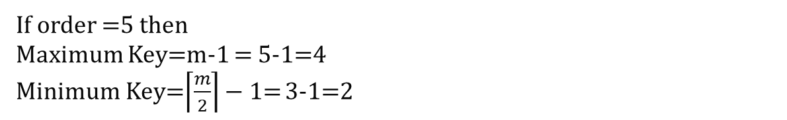
B Tree (Deletion)
Example 2:
Perform the deletion operation with the following data sequentially on the given B-Tree of order 5.
<25 75 27 5 15 81 97 112 10 >
9
25
75
1
3
5
8
10
15
27
35
81
97
112
If order =5 then
Maximum Key=m-1 = 5-1=4
Minimum Key=$\left\lceil \frac{m}{2}\right\rceil −1$= 3-1=2

Slide 127
B Tree (Deletion)
Example 2:
Perform the deletion operation with the following data sequentially on the given B-Tree of order 5.
<25 75 27 5 15 81 97 112 10 >
Delete :25
key
9
25
75
1
3
5
8
10
15
27
35
81
97
112

Slide 128
B Tree (Deletion)
Example 2:
Perform the deletion operation with the following data sequentially on the given B-Tree of order 5.
<25 75 27 5 15 81 97 112 10 >
Delete :25
key
9
25
75
1
3
5
8
10
15
27
35
81
97
112
Apply Case 2(c)

Slide 129
B Tree (Deletion)
Example 2:
Perform the deletion operation with the following data sequentially on the given B-Tree of order 5.
<25 75 27 5 15 81 97 112 10 >
Delete :25
key
9
25
75
1
3
5
8
10
15
27
35
81
97
112
Apply Case 2(c)
9
75
1
3
5
8
10
15
27
35
81
97
112

Slide 130
B Tree (Deletion)
Example 2:
Perform the deletion operation with the following data sequentially on the given B-Tree of order 5.
<25 75 27 5 15 81 97 112 10 >
Delete :75
9
75
key
1
3
5
8
10
15
27
35
81
97
112

Slide 131
B Tree (Deletion)
Example 2:
Perform the deletion operation with the following data sequentially on the given B-Tree of order 5.
<25 75 27 5 15 81 97 112 10 >
Delete :75
9
75
key
1
3
5
8
10
15
27
35
81
97
112
Apply Case 2(a)

Slide 132
B Tree (Deletion)
Example 2:
Perform the deletion operation with the following data sequentially on the given B-Tree of order 5.
<25 75 27 5 15 81 97 112 10 >
Delete :75
9
75
key
1
3
5
8
10
15
27
35
81
97
112
Apply Case 2(a)
9
35
1
3
5
8
10
15
27
81
97
112

Slide 133
B Tree (Deletion)
Example 2:
Perform the deletion operation with the following data sequentially on the given B-Tree of order 5.
<25 75 27 5 15 81 97 112 10 >
Delete :27
9
35
1
3
5
8
10
15
27
key
81
97
112

Slide 134
B Tree (Deletion)
Example 2:
Perform the deletion operation with the following data sequentially on the given B-Tree of order 5.
<25 75 27 5 15 81 97 112 10 >
Delete :27
9
35
1
3
5
8
10
15
27
key
81
97
112
Apply Case 1
9
35
1
3
5
8
10
15
81
97
112

Slide 135
B Tree (Deletion)
Example 2:
Perform the deletion operation with the following data sequentially on the given B-Tree of order 5.
<25 75 27 5 15 81 97 112 10 >
Delete :5
9
35
key
1
3
5
8
10
15
81
97
112

Slide 136
B Tree (Deletion)
Example 2:
Perform the deletion operation with the following data sequentially on the given B-Tree of order 5.
<25 75 27 5 15 81 97 112 10 >
Delete :5
9
35
key
1
3
5
8
10
15
81
97
112
Apply Case 1

Slide 137
B Tree (Deletion)
Example 2:
Perform the deletion operation with the following data sequentially on the given B-Tree of order 5.
<25 75 27 5 15 81 97 112 10 >
Delete :5
9
35
key
1
3
5
8
10
15
81
97
112
Apply Case 1
9
35
1
3
8
10
15
81
97
112

Slide 138
B Tree (Deletion)
Example 2:
Perform the deletion operation with the following data sequentially on the given B-Tree of order 5.
<25 75 27 5 15 81 97 112 10 >
Delete :15
9
35
key
1
3
8
10
15
81
97
112

Slide 139
B Tree (Deletion)
Example 2:
Perform the deletion operation with the following data sequentially on the given B-Tree of order 5.
<25 75 27 5 15 81 97 112 10 >
Delete :15
9
35
key
1
3
8
10
15
81
97
112
Apply Case 3(a)

Slide 140
B Tree (Deletion)
Example 2:
Perform the deletion operation with the following data sequentially on the given B-Tree of order 5.
<25 75 27 5 15 81 97 112 10 >
Delete :15
9
35
key
1
3
8
10
15
81
97
112
Apply Case 3(a)
9
81
1
3
8
10
35
97
112

Slide 141
B Tree (Deletion)
Example 2:
Perform the deletion operation with the following data sequentially on the given B-Tree of order 5.
<25 75 27 5 15 81 97 112 10 >
Delete :81
key
9
81
1
3
8
10
35
97
112

Slide 142
B Tree (Deletion)
Example 2:
Perform the deletion operation with the following data sequentially on the given B-Tree of order 5.
<25 75 27 5 15 81 97 112 10 >
Delete :81
key
9
81
1
3
8
10
35
97
112
Apply Case 2(c)

Slide 143
B Tree (Deletion)
Example 2:
Perform the deletion operation with the following data sequentially on the given B-Tree of order 5.
<25 75 27 5 15 81 97 112 10 >
Delete :81
key
9
81
1
3
8
10
35
97
112
Apply Case 2(c)
9
1
3
8
10
35
97
112

Slide 144
B Tree (Deletion)
Example 2:
Perform the deletion operation with the following data sequentially on the given B-Tree of order 5.
<25 75 27 5 15 81 97 112 10 >
Delete :97
9
key
1
3
8
10
35
97
112
Apply Case 1

Slide 145
B Tree (Deletion)
Example 2:
Perform the deletion operation with the following data sequentially on the given B-Tree of order 5.
<25 75 27 5 15 81 97 112 10 >
Delete :97
9
key
1
3
8
10
35
97
112
Apply Case 1
9
1
3
8
10
35
112

Slide 146
B Tree (Deletion)
Example 2:
Perform the deletion operation with the following data sequentially on the given B-Tree of order 5.
<25 75 27 5 15 81 97 112 10 >
Delete :112
9
key
1
3
8
10
35
112

Slide 147
B Tree (Deletion)
Example 2:
Perform the deletion operation with the following data sequentially on the given B-Tree of order 5.
<25 75 27 5 15 81 97 112 10 >
Delete :112
9
key
1
3
8
10
35
112
Apply Case 1

Slide 148
B Tree (Deletion)
Example 2:
Perform the deletion operation with the following data sequentially on the given B-Tree of order 5.
<25 75 27 5 15 81 97 112 10 >
Delete :112
9
key
1
3
8
10
35
112
Apply Case 1
9
1
3
8
10
35

Slide 149
B Tree (Deletion)
Example 2:
Perform the deletion operation with the following data sequentially on the given B-Tree of order 5.
<25 75 27 5 15 81 97 112 10 >
Delete :10
9
key
1
3
8
10
35

Slide 150
B Tree (Deletion)
Example 2:
Perform the deletion operation with the following data sequentially on the given B-Tree of order 5.
<25 75 27 5 15 81 97 112 10 >
Delete :10
9
key
1
3
8
10
35
Apply Case 3(a)

Slide 151
B Tree (Deletion)
Example 2:
Perform the deletion operation with the following data sequentially on the given B-Tree of order 5.
<25 75 27 5 15 81 97 112 10 >
Delete :10
9
key
1
3
8
10
35
Apply Case 2(a)
Final Tree
8
1
3
9
35

Slide 152
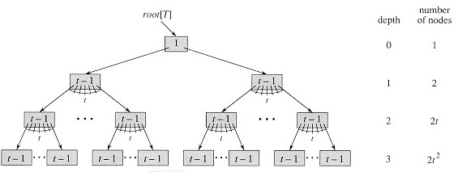

B Tree (Deletion)
Theorem:
If $n≥1,$then for any n- key B-Tree T of height h and minimum degree $t≥2,$ then $h≤\log_{t}{\frac{n+1}{2}}$.
Proof:
The root of B-Tree contains at least one keys and all other nodes contain at least t-1 keys.
Thus T, whose height is h, has at least 2 nodes at depth 1. 2t nodes at depth 2, at least ${2t}^{2}$ node at depth 3, and so on until it has at least ${2t}^{h−1}$nodes.
Figure A B-tree of height 3 containing a minimum possible number of keys. Shown inside each node x is n[x].

Slide 153
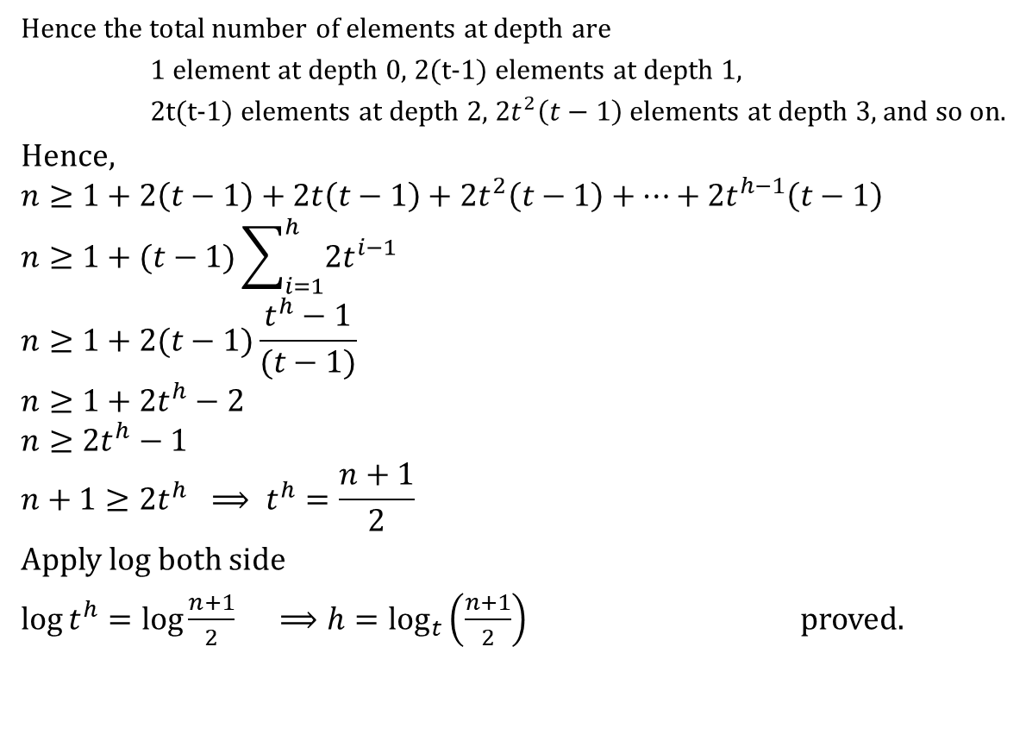
B Tree (Deletion)
Hence the total number of elements at depth are
1 element at depth 0, 2(t-1) elements at depth 1,
2t(t-1) elements at depth 2, ${2t}^{2}\left(t−1\right)$ elements at depth 3, and so on.
Hence,
$$n≥1+2\left(t−1\right)+2t\left(t−1\right)+{2t}^{2}\left(t−1\right)+…+{2t}^{h−1}\left(t−1\right)$$
$$n≥1+(t−1)\sum_{i=1}^{h}{2t^{i−1}}$$
$$n≥1+2(t−1)\frac{t^{h}−1}{(t−1)}$$
$$n≥1+2t^{h}−2$$
$$n≥2t^{h}−1$$
$$n+1≥2t^{h} ⟹ t^{h}=\frac{n+1}{2}$$
Apply log both side
$\log{t^{h}=\log{\frac{n+1}{2}}} ⟹h=\log_{t}\left(\frac{n+1}{2}\right)$ proved.

Slide 154

Thank U

